Slide 1
GARMENTS INVENTORY MANAGEMENT SYSTEM

Slide 2
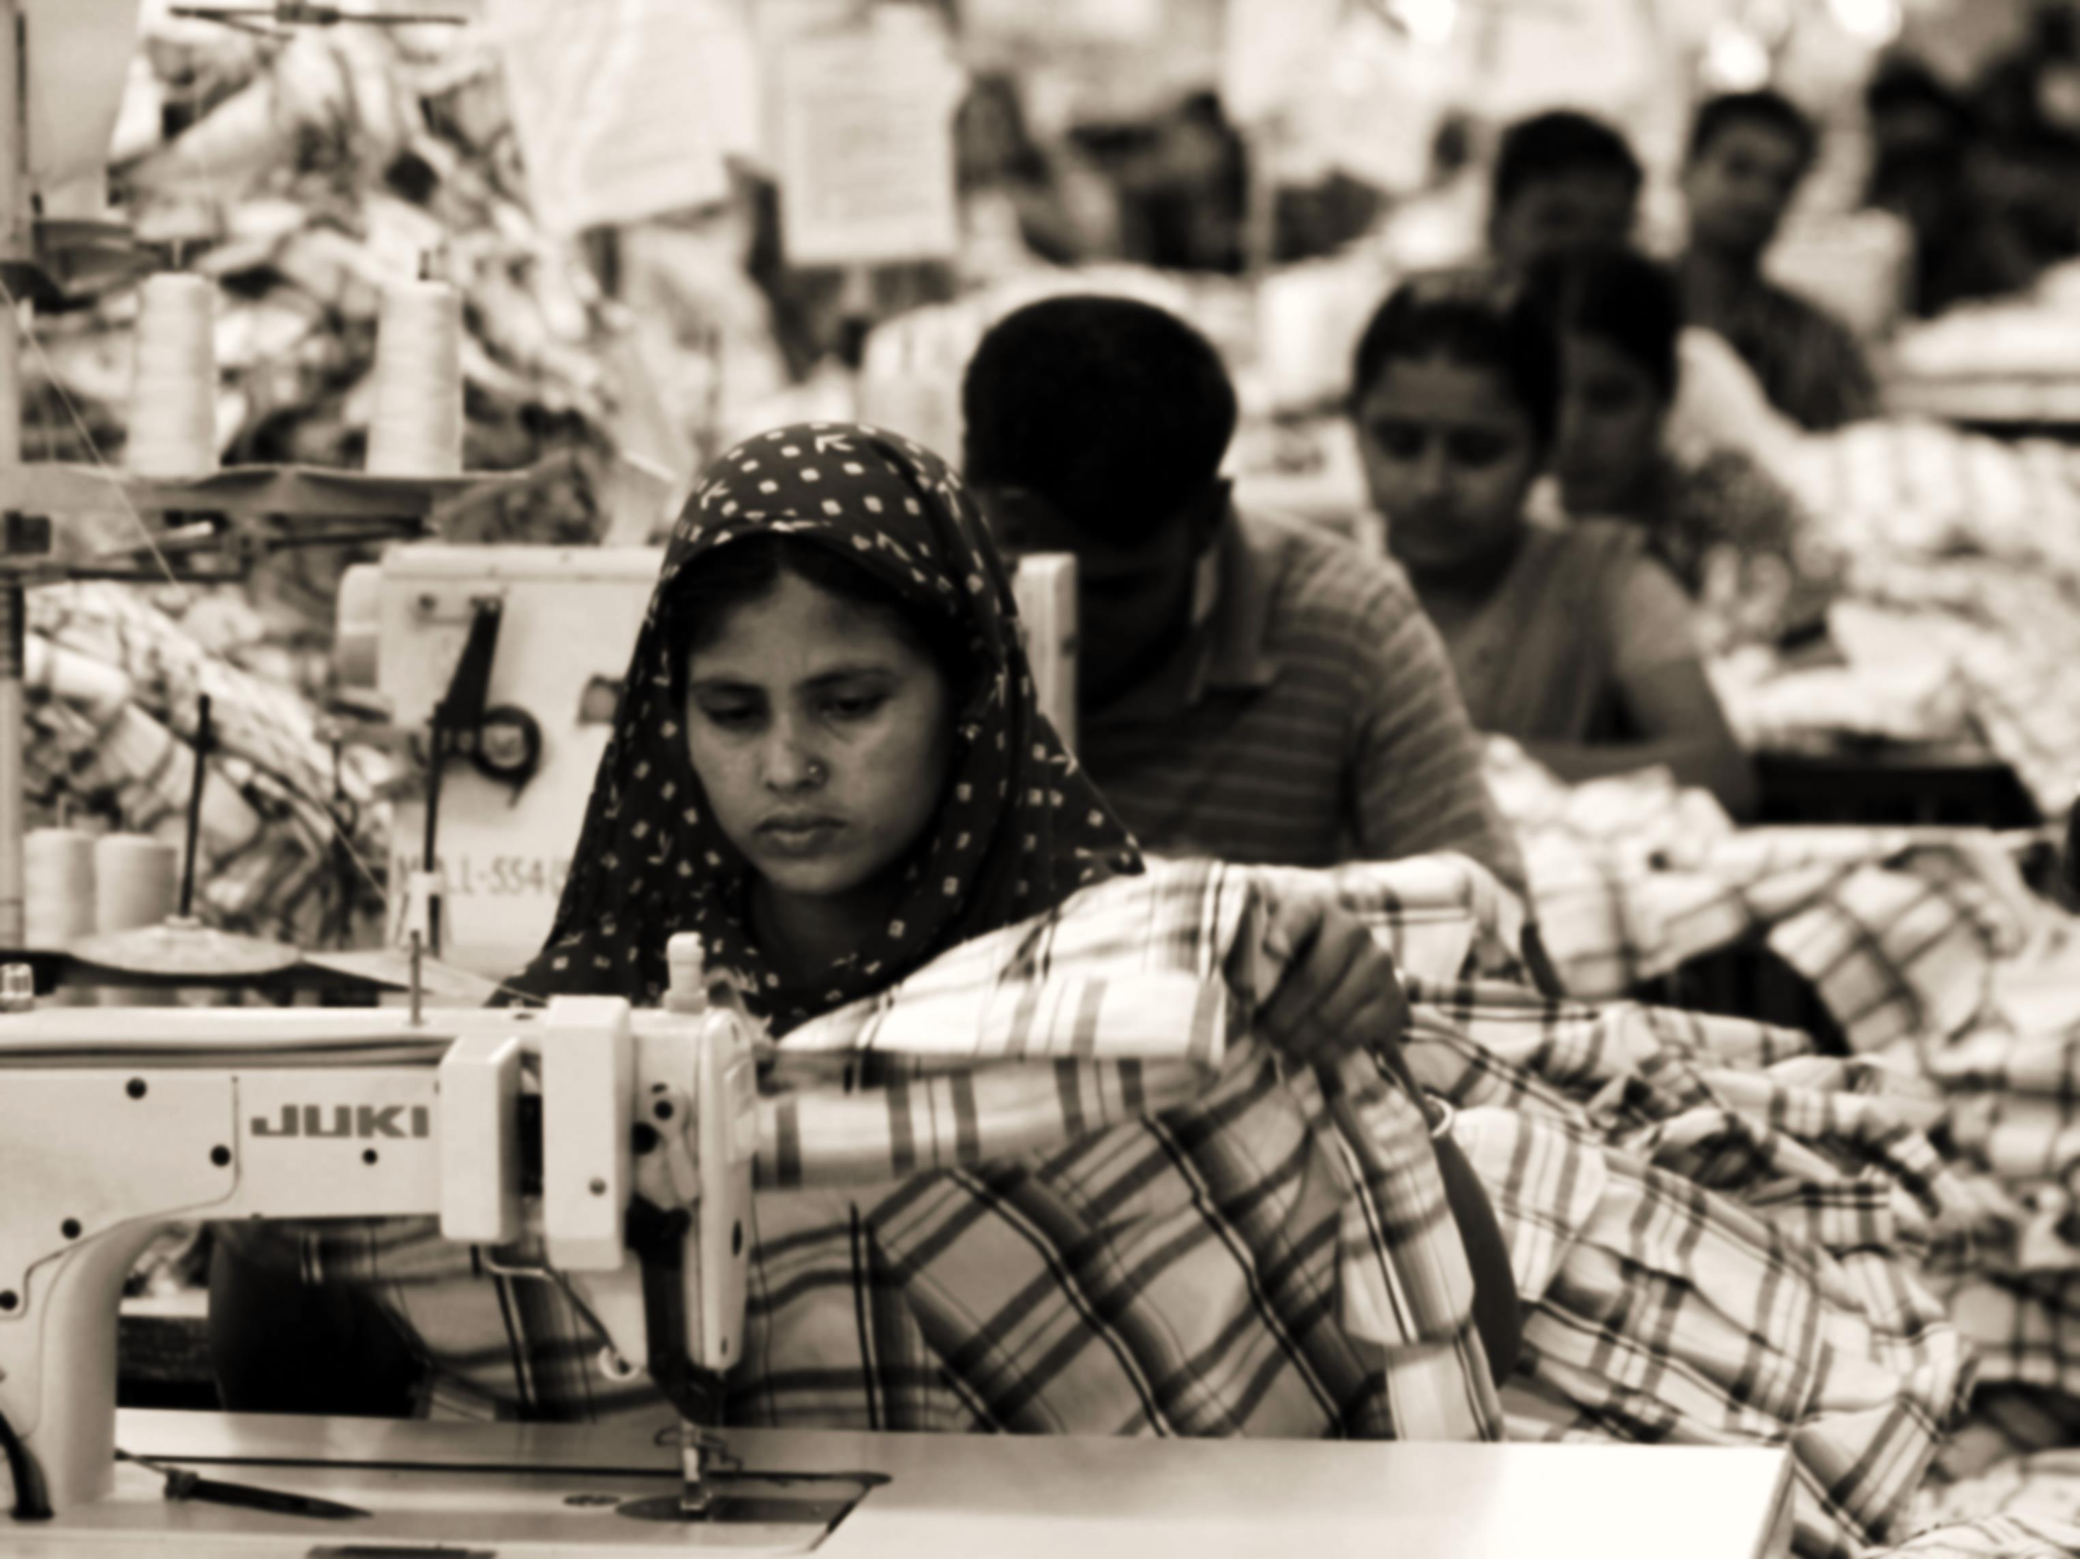
The Endless Possibility Economy of Bangladesh is largely dependent on the garments sector. It has attracted worldwide attention.
3.6 million active workers.*
78% of total export earn.*
More enormous investment to come.

Slide 3
SUBSYSTEMS
Raw material storage
Raw material forwarding
Production stage tracking
Delivery subsystem

Slide 4
RAW MATERIAL STORAGE
SUBSYSTEM 1

Slide 5
Raw material storage Actor’s Glossary
ACTOR | SHORT KEY | ACTIVITY SCOPE
Main office | MO | Places a demand for raw material, gives confirmation on receiving materials
Storage manager | SM | Checks and updates the storage balance
Storage worker | SW | Inputs the products in storage
Production manager | PM | Starts production on receiving materials

Slide 6
Raw material storage Use Case Glossary
Use case name | Use case id | Description | Participant actors and roles
Get user demand | 1.1 | filling up a demand form depending on the nature of the contract | MO fills the form, SM receives it.
Match type | 1.2 | After receiving the demands, the type of the products is matched | SW matches the requirements
Match quantity | 1.3 | After receiving the demands ,the quantity is matched | Same as type matching
Confirm order | 1.4 | After matching the order is confirmed | SM confirms the order, sends the goods to the factory, PM receives it, starts production, MO receives confirmation
Update storage balance | 1.5 | After sending an order, the balance of storage is updated | SW updates the balance, SM oversees it for transparency.
Check storage balance | 1.6 | checking the current balance of the inventory at any time. | MO checks the balance, system provides output.

Slide 7
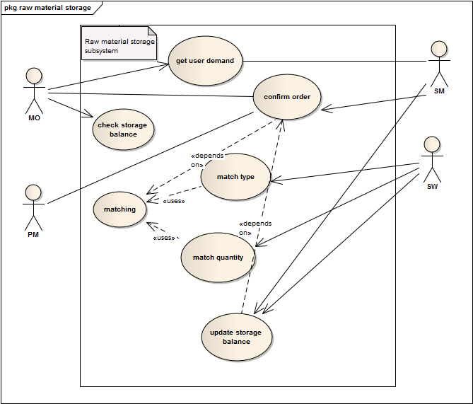
Raw material storage Use Case Diagram

Slide 8
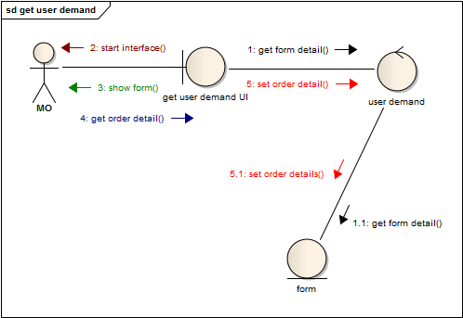
Raw material storage
1.1 Get User Demand

Slide 9
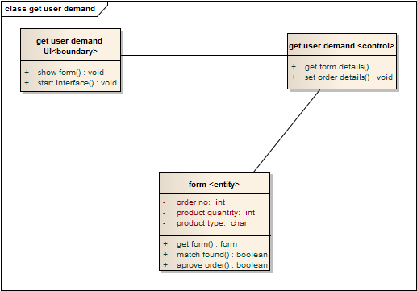
Raw material storage
1.1 Get User Demand

Slide 10
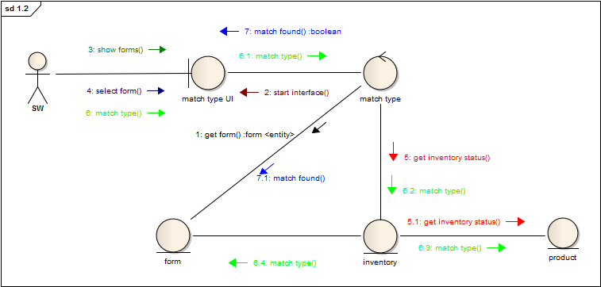
Raw material storage
1.2 Match Type

Slide 11
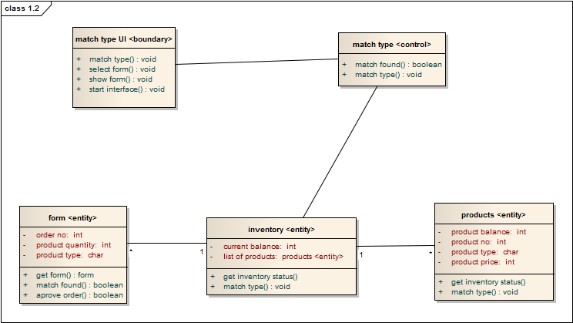
Raw material storage
1.2 Match Type

Slide 12
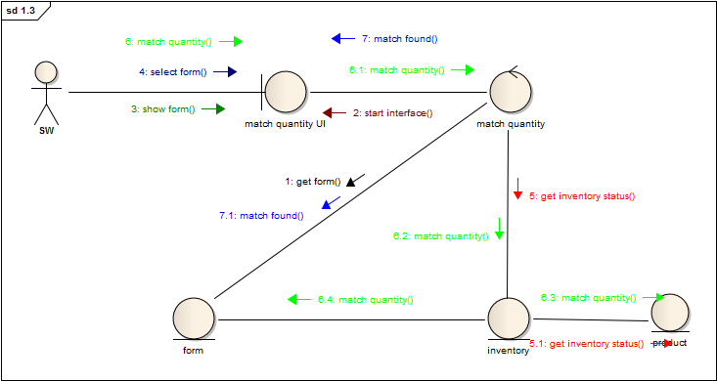
Raw material storage
1.3 Match Quantity

Slide 13
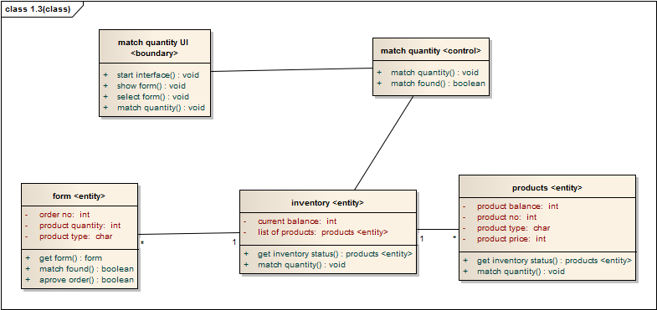
Raw material storage
1.3 Match Quantity

Slide 14
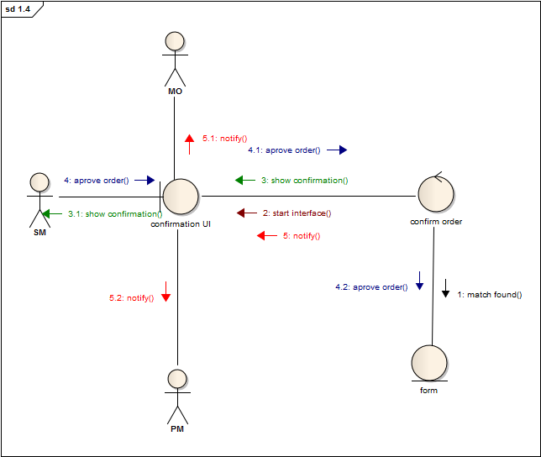
Raw material storage
1.4 Confirm Order

Slide 15
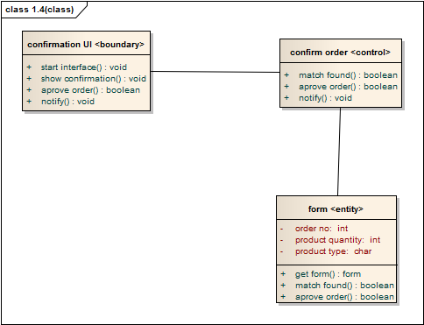
Raw material storage
1.4 Confirm Order

Slide 16
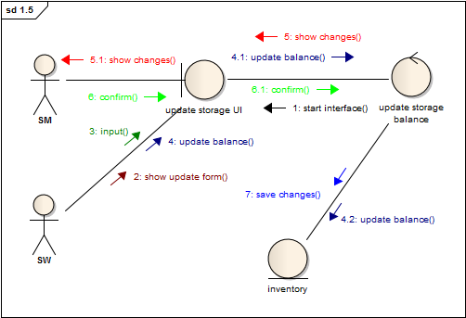
Raw material storage
1.5 Update Storage Balance

Slide 17
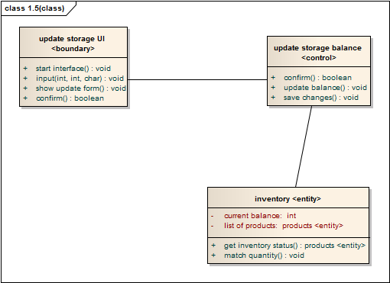
Raw material storage
1.5 Update Storage Balance

Slide 18
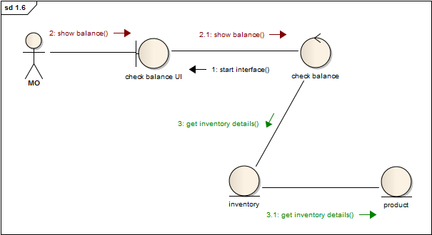
Raw material storage
1.6 Check Storage Balance

Slide 19
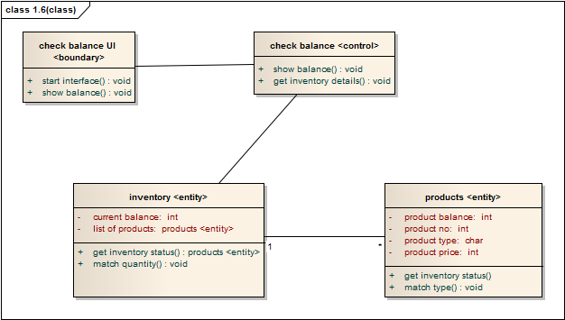
Raw material storage
1.6 Check Storage Balance

Slide 20
PRODUCTION STAGE TRACKING
SUBSYSTEM 3

Slide 21
Production Stage Tracking Actor’s Glossary
Actor name | Short key | Activity scope
Production manager | PM | updates the status of production, sends confirmation to MO, forwards the products to DM.
Section supervisor | SS | updates the status of production in his section, checks for defected products, sends report to PM
production workers | PW | inputs the finished and defected production status

Slide 22
Production Stage Tracking Use Case Glossary
Use case name | Use case id | Description | Participant actors and roles
view cutting status | 3.1 | Checking and updating cutting section product status | cutting section SS updates , PM checks it
view sewing status | 3.2 | Checking and updating sewing section product status | sewing section SS updates , PM checks it
view packing status | 3.3 | Checking and updating packing section product status | packing section SS updates , PM checks it
view defection status | 3.4 | Checking and updating defected product status | CSS,SSS,PSS inputs, PM checks
Update production completion status | 3.5 | Updating total production status of the order | PM updates

Slide 23
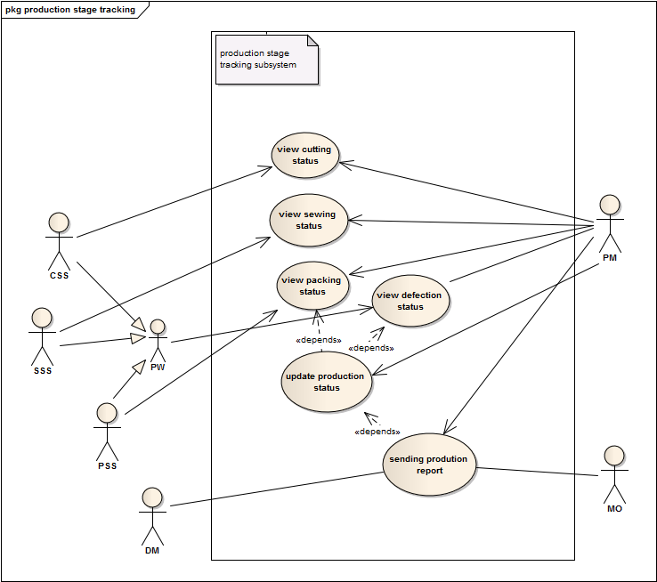
Production Stage Tracking Use Case Diagram

Slide 24
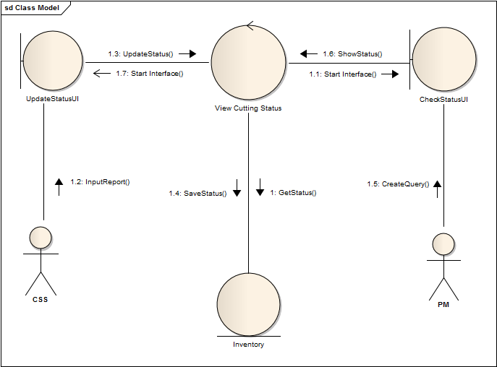
Production Stage Tracking
3.1 View Cutting Status

Slide 25
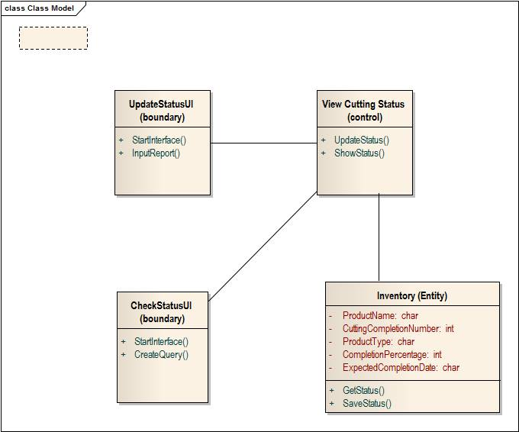
Production Stage Tracking
3.1 View Cutting Status

Slide 26
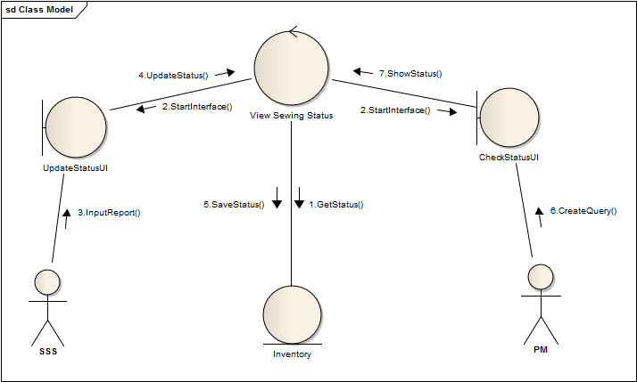
Production Stage Tracking
3.2 View Sewing Status

Slide 27

Production Stage Tracking
3.2 View sewing Status

Slide 28

Production Stage Tracking
3.3 View Packing Status

Slide 29

Production Stage Tracking
3.3 View Packing Status

Slide 30
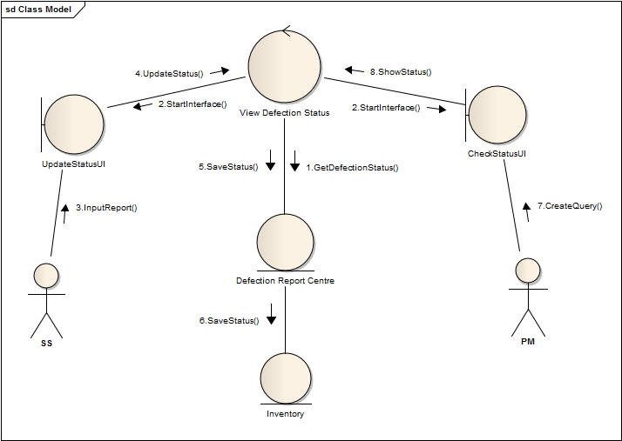
Production Stage Tracking
3.4 View Defection Status

Slide 31
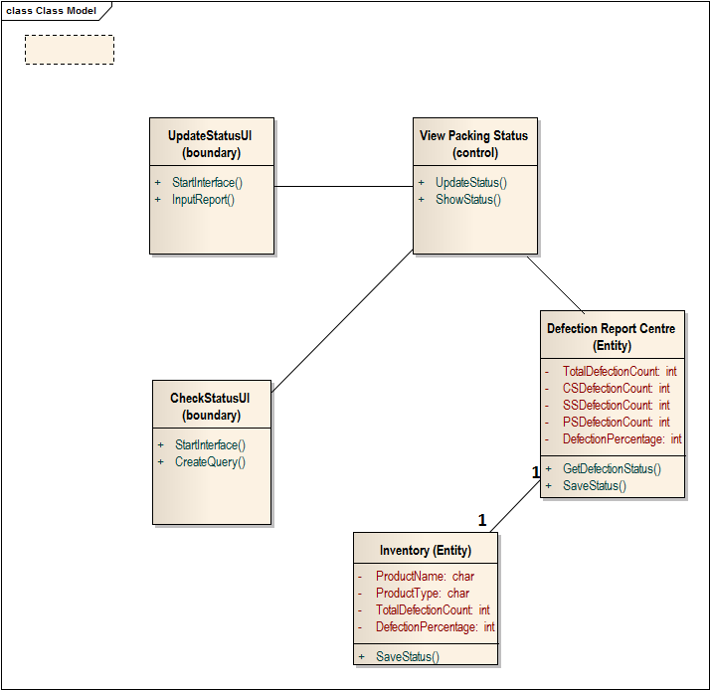
Production Stage Tracking
3.4 View Defection Status

Slide 32
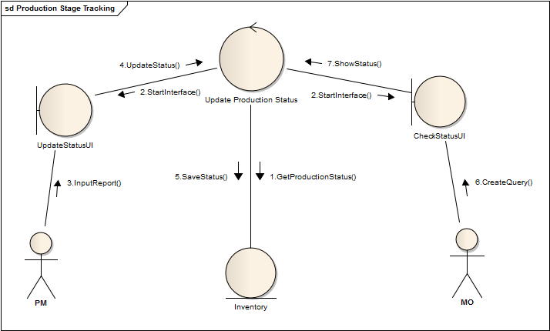
Production Stage Tracking
3.5 Update Production Completion Status

Slide 33
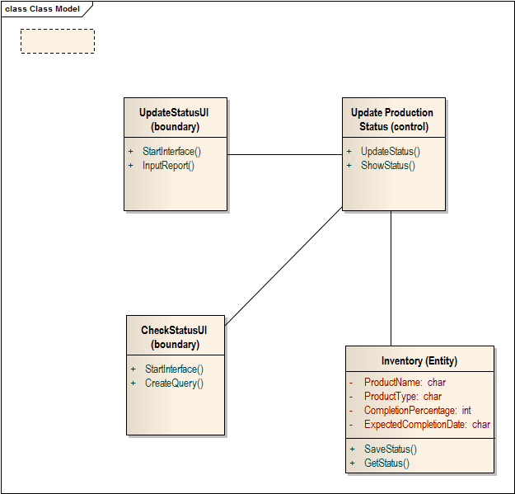
Production Stage Tracking
3.5 Update Product Completion Status

Slide 34
THANK YOU!

Slide 35
RAW MATERIAL FORWARDING
SUBSYSTEM 2

Slide 36
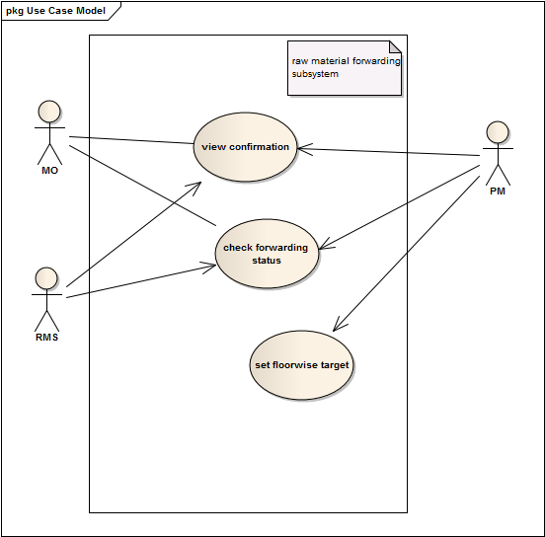
Raw material Forwarding Use Case Diagram

Slide 37
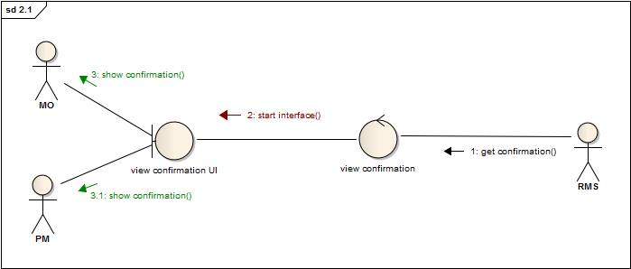
Raw material Forwarding 2.1 View Confirmation

Slide 38
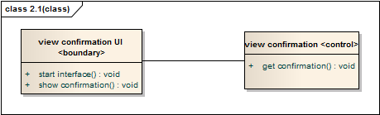
Raw material Forwarding 2.1 View Confirmation

Slide 39
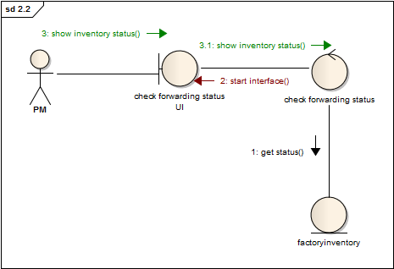
Raw material Forwarding 2.2 Check Forwarding Status

Slide 40
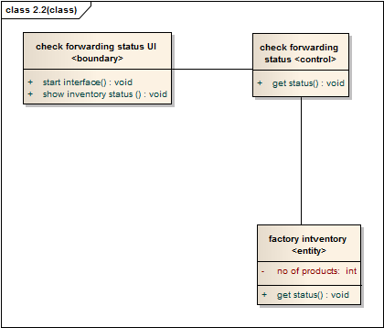
Raw material Forwarding 2.2 Check Forwarding Status

Slide 41
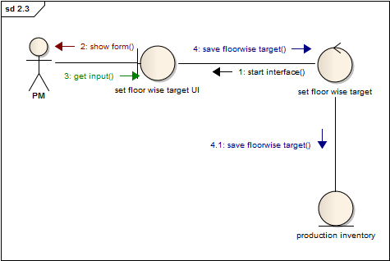
Raw material Forwarding 2.3 Set Floor-wise Target

Slide 42
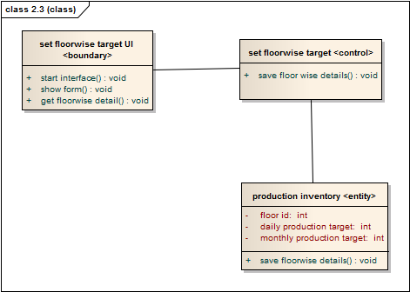
Raw material Forwarding 2.3 Set Floor-wise Target

Slide 43
DELIVERY OF PRODUCTS
SUBSYSTEM 4

Slide 44
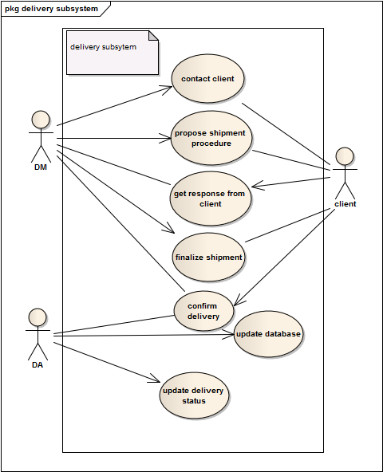
Delivery Of Products Use Case Diagram

Slide 45
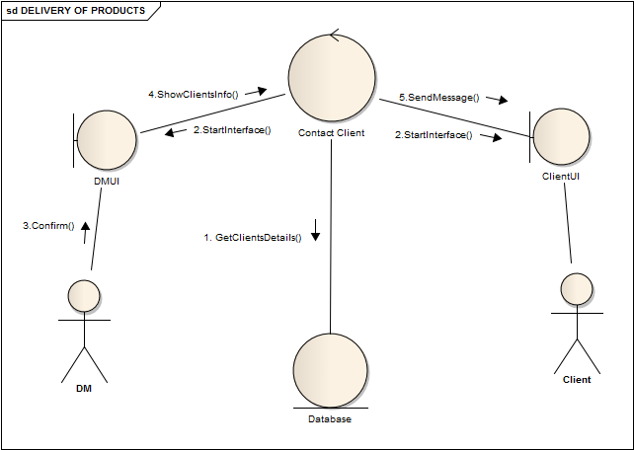
Delivery Of Products 4.1 Contact Client

Slide 46
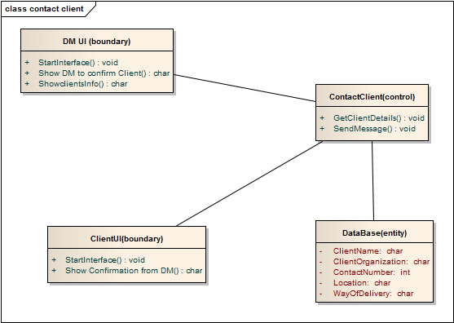
Delivery Of Products 4.1 Contact Client

Slide 47
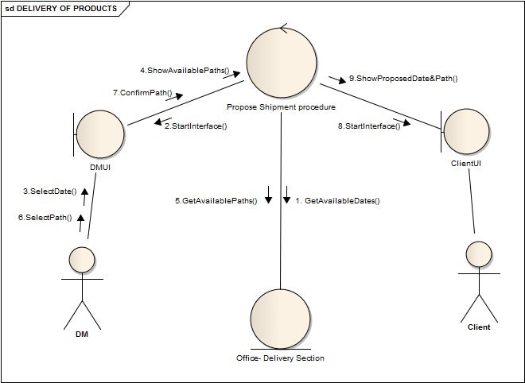
Delivery Of Products 4.2 Propose Shipment Procedure

Slide 48
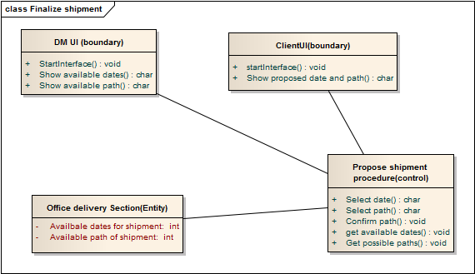
Delivery Of Products 4.2 Propose Shipment Procedure

Slide 49
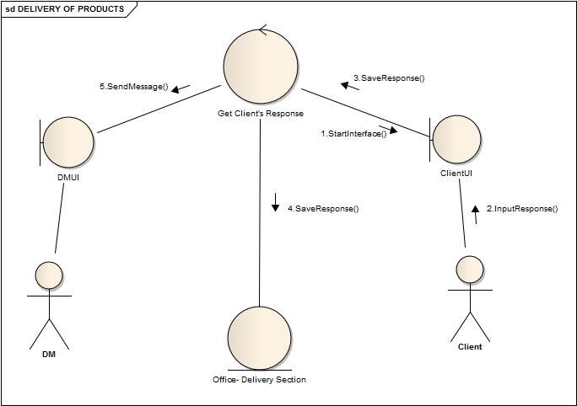
Delivery Of Products 4.3 Get Response from Client

Slide 50
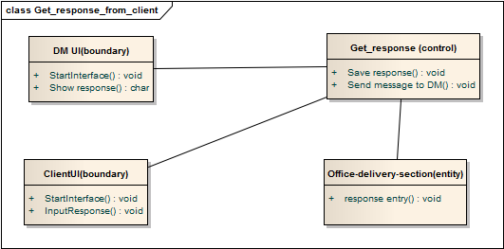
Delivery Of Products 4.3 Get Response from Client

Slide 51
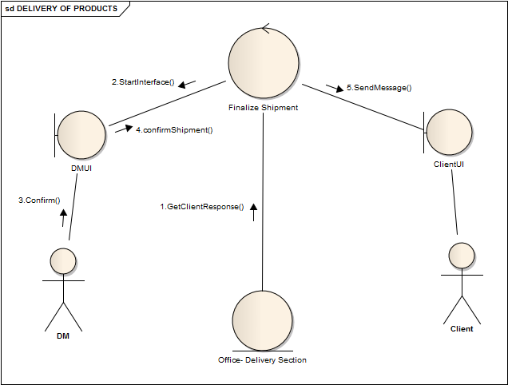
Delivery Of Products 4.4 Finalize Shipment

Slide 52
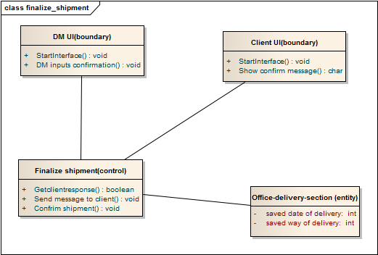
Delivery Of Products 4.4 Finalize Shipment

Slide 53
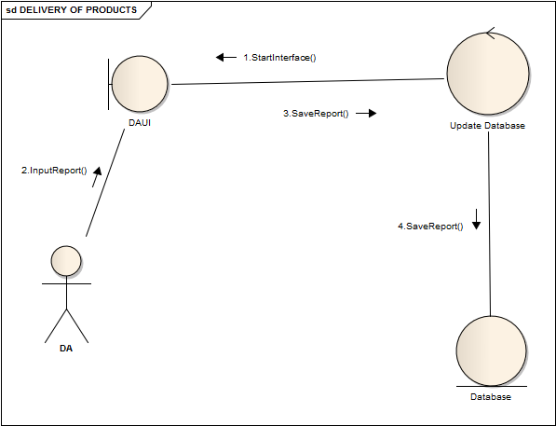
Delivery Of Products 4.5 Update Database

Slide 54
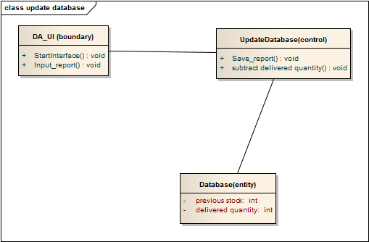
Delivery Of Products 4.5 Update Database

Slide 55
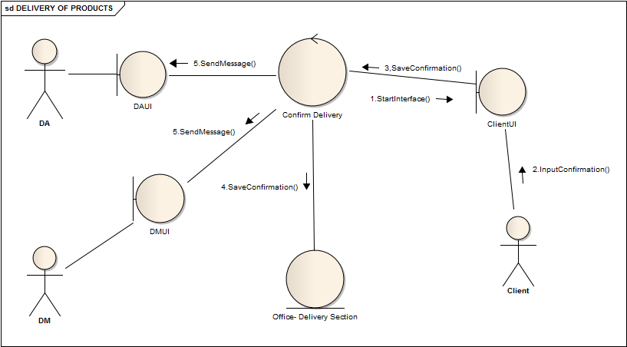
Delivery Of Products 4.6 Confirm Delivery

Slide 56
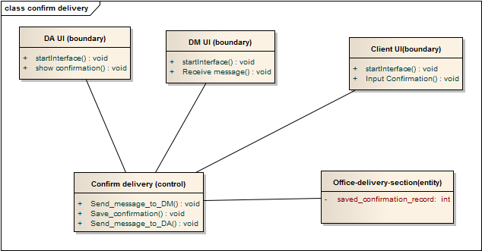
Delivery Of Products 4.6 Confirm Delivery

Slide 57
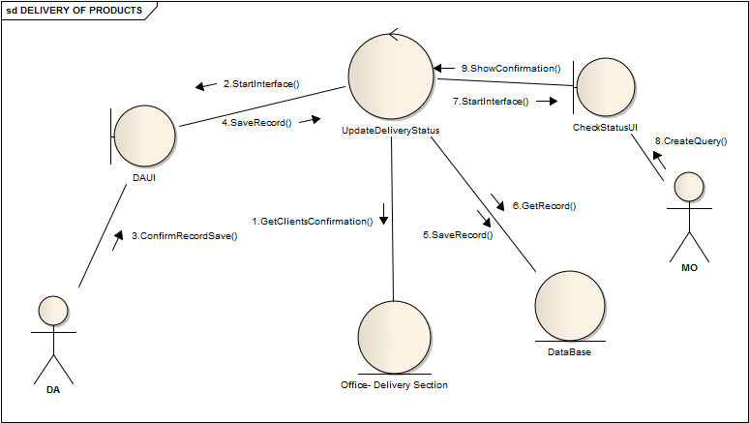
Delivery Of Products 4.7 Update Delivery Status

Slide 58
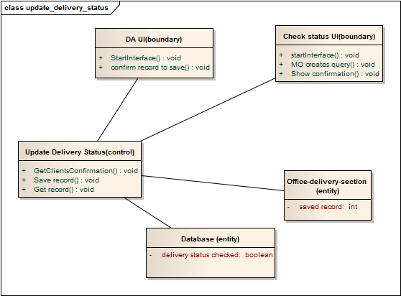
Delivery Of Products 4.7 Update Delivery Status

